Slide 1
Microphones
Rule 1: there are no rules (but there are guidelines)
Rule 2: the final audio signal is no stronger than the weakest link in the line
Rule 3: the ‘good’ rule: good musician + good acoustics + good mike + good preamp + good placement = a good sound
Notes:
Mics are tools, different sounds, require some familiarity, where the line in the signal/source begins

Slide 2
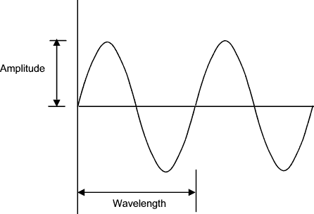
Transducers
Element that converts audio wave into electrical signal
Notes:
Perceived volume verses frequency, diaphragms vibrate – elements move, creating an electrical signal that moves in syncopation with sound wave in the air, sending electrical signal down the line

Slide 3
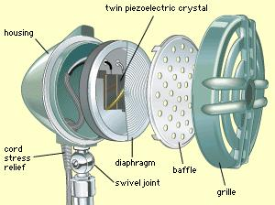
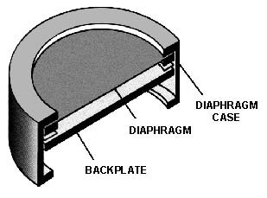
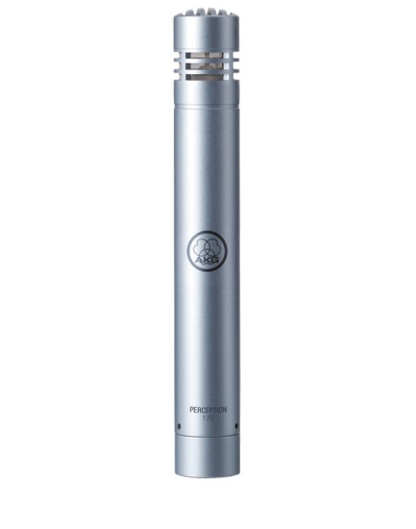
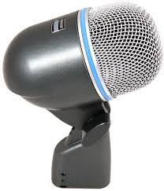
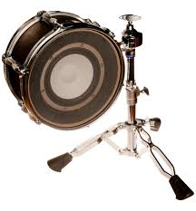
Diaphragms
Frequency – large v. small
Notes:
Where the vibrations of the soundwaves are perceived and transformed into electrical signal. Size of the diaphragm limits the frequency that is translated.

Slide 4
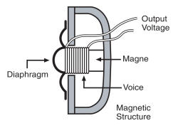
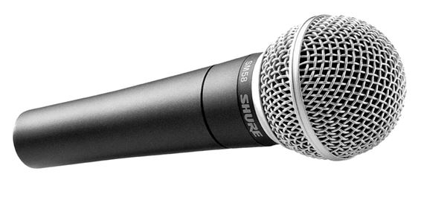
Dynamic Mics
Works by electromagnetic induction
Magnets and diaphragm
Does not need
phantom power
Notes:
Does not need phantom power, but isn’t hurt if it sees it – sound waves in the air are enough to create/push the signal, not terribly sensitive and fairly sturdy, makes them good for using in a live situation, size of diaphragm influence signal that’s created

Slide 5
Condenser Mics
Works by electrostatic principle
Two thin plates – one fixed and one moves
Plates form capacitor and store elec. charge
Soundwave effects capacitance, which effects voltage, thus sending electrical signal
Large v. small diaphragm
Requires phantom power
Sensitive signal
Notes:
Requires phantom power to operate, still about an element moving in syncopation with the soundwave in the air, in this case the element, requires electricity to function. Much more sensitive and more fragile, better for recording (and live acoustic instruments in the right setting). Diaphragm limits still apply – small v. large diaphragm

Slide 6
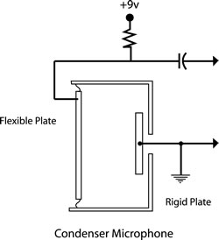
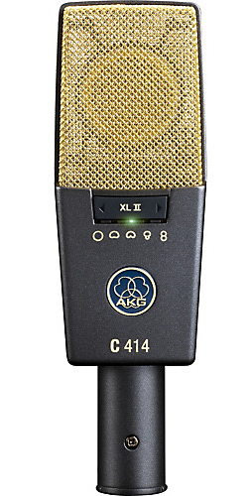
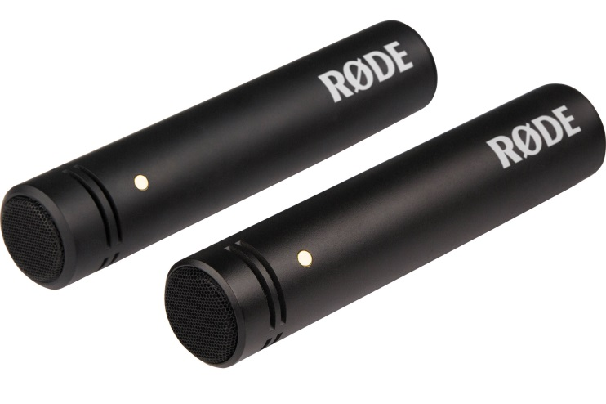
Condenser Mics 2

Slide 7
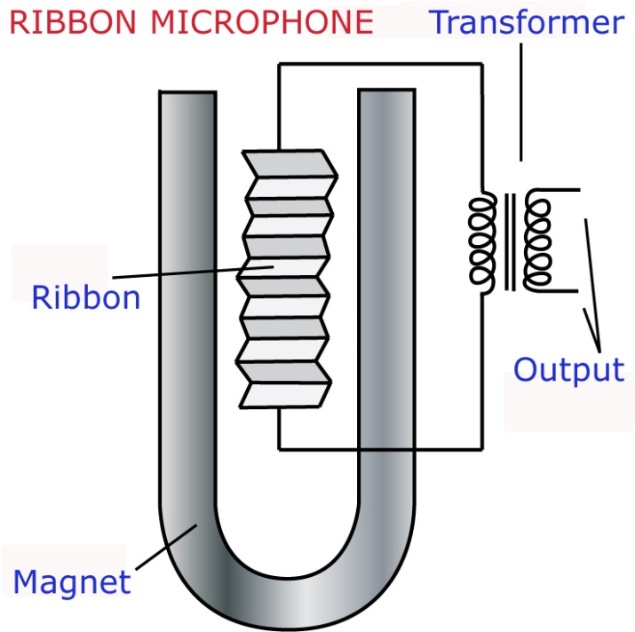
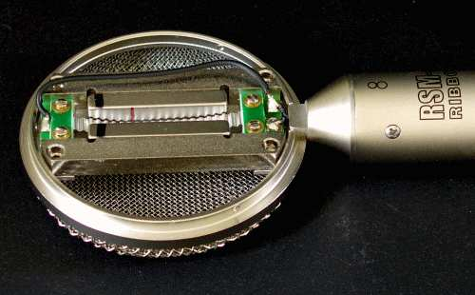
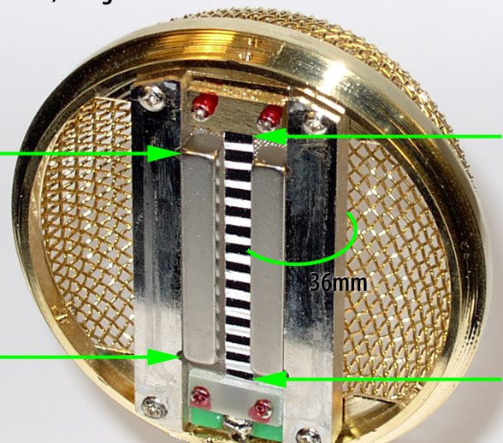
Ribbon Mics
Also, works by electromagnetic induction
But, diaphragm is a thin aluminum ribbon
DO NOT use phantom power
Notes:
Similar to dynamics, but the thing the element that syncopates with the sound waves is a small thin ribbon. Must be very careful to not use phantom power; the electricity will damage this kind of mic

Slide 8
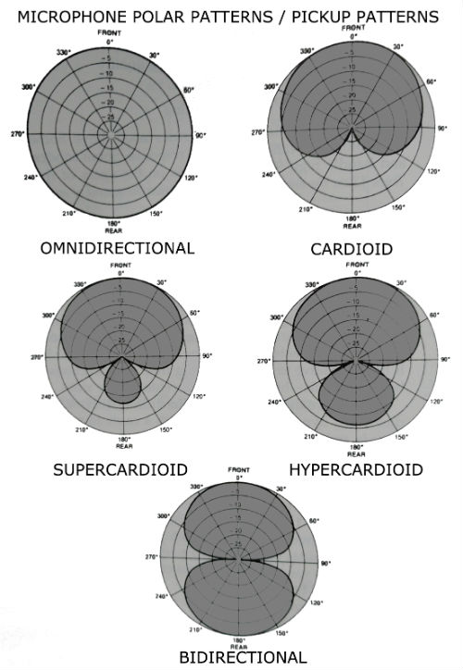
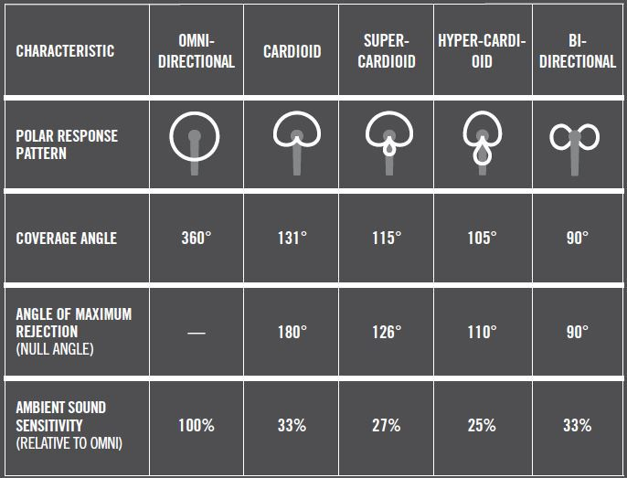
Pickup patterns
Directional response of microphones
Unidirectional
Bidirectional
Omnidirectional
Notes:
Characteristics of the microphone’s design will influence how it picks up the sound in a room. Directionality. Different kinds of directionality can be used for different applications.

Slide 9
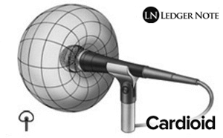
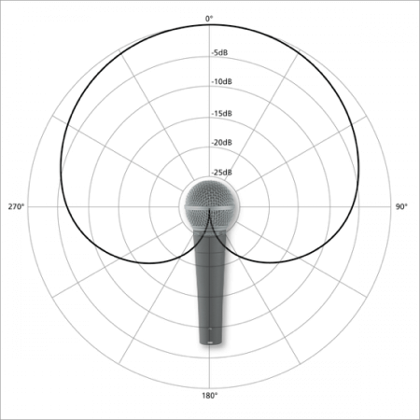
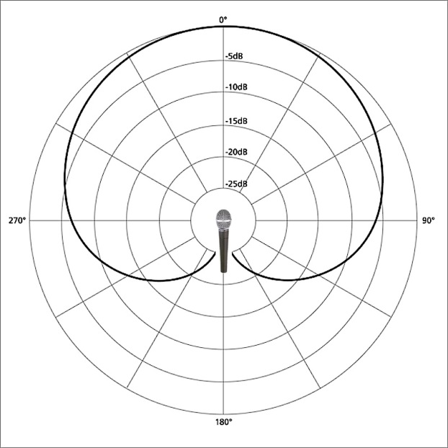
Cardioid
Unidirectional
Heart-shaped
Notes:
Picks up in one direction and rejects a lot of sound behind it (off-axis). Very helpful in live sound and recording situations where you want separation (no bleed over of one instrument into another’s mic). Most common

Slide 10
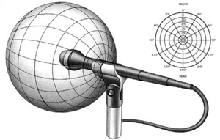
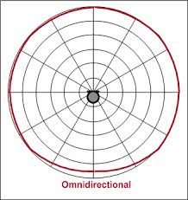
Omnidirectional
Picks up from all directions
Spherical
Notes:
Picks up in all directions around the element. Genuinely catching sound from all around the room.

Slide 11
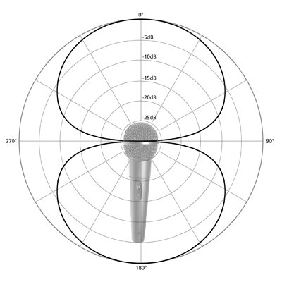
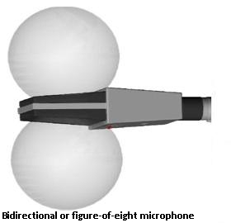
Figure 8
Bi-directional
Picks up front
and back
Notes:
Picks up immediately in front of and immediately behind the microphone element. Rejects sound from its sides. Good for interviews between two people.

Slide 12
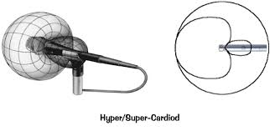
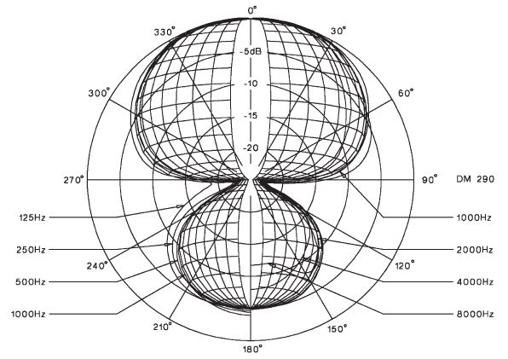
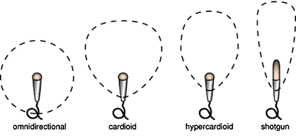
Hyper- and Super-cardioid
Unidirectional with tailored shaping
Notes:
Different pick up patterns, still unidirectional but varies in width of pickup pattern. May also pick up more from directly behind the element. Shotgun mics are great for videos and interviews. Hyper/Super-cardioids can be good for live sound (better for feedback control).

Slide 13
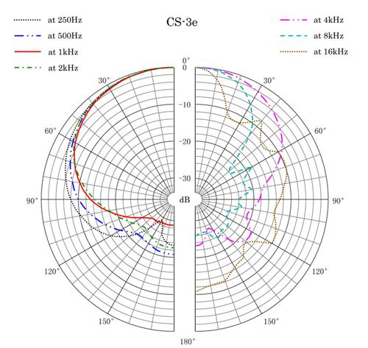
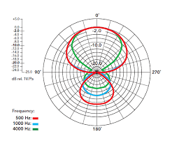
Frequency Response
Frequencies picked up vary along the pattern
Proximity effect
Notes:
Along the expanse of the pickup pattern, frequencies are not picked up evenly. Frequency response will vary within the pickup pattern. Dynamic mics – pick up more lower frequencies the closer it gets to the source

Slide 14
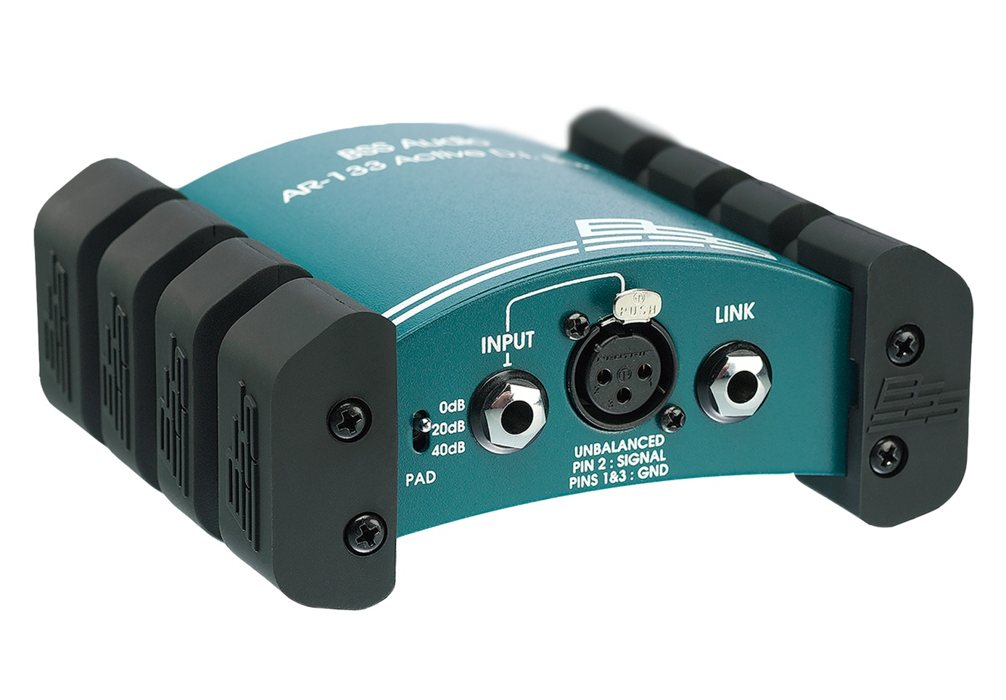
Direct Injection
Inject signal of electric instrument to mixer
DI Box
Notes:
Takes signal and splits it, including an output that can interface well with a console (i.e. plugs into a mixing board) while also passing the original signal through, often includes a ground life and a pad (to attend to signal levels)

Slide 15
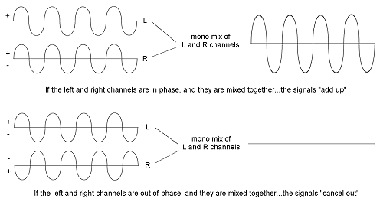
Phasing
Interaction of waves
Notes:
In phase = good, out of phase = not include, unless it’s making a sound that you like (i.e. phaser, flanger)
Mic setups to reduce phase
Invert buttons

Slide 16
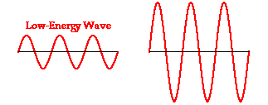
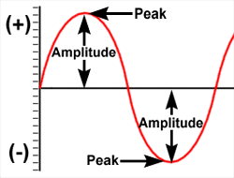
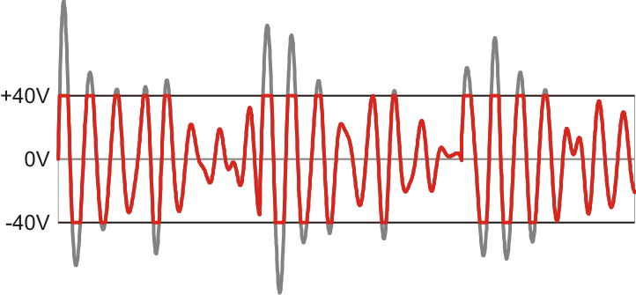
SPL
Amplitude
Clipping
Notes:
Point that is the limit, where the signal is as loud as that point in the path can take it. Waterfalls?
As full as possible, but not too much.
Analog v. digital

Slide 17
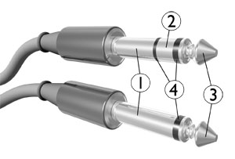
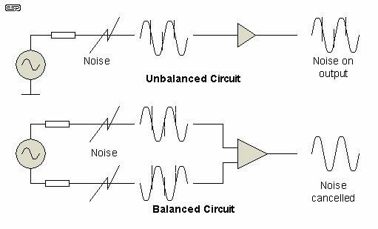
Impedance
Matching signals
Balanced v. unbalanced
Notes:
Line level, mic level, instrument level – too much or too little is ill-preferred, want a full signal, but that’s not clipping (unless that’s a sound you’re specifically looking for)…
Balanced cables, removes signal noise – refer to phase – TRS and XLR, TS plugs

